Slide 1
A quick pre-test

Slide 2
Which country in each pair has higher child mortality?
Pairs chosen where one country has > twice the child mortality rate of the other
15 Sri Lanka or Turkey 22
7 Poland or South Korea 5
Cuba or Russia 13
14 Thailand or South Africa 67
31 Botswana or India 69
14 Romania or Chile 9
8 United States or Slovenia 4
32 Iran or Bangladesh 54
Namibia or Cambodia 90
89 Pakistan or Vietnam 14
4 Germany or Singapore 3
12 Seychelles or Mexico 17
Namibia or Cambodia 90

Slide 3
Countries having > twice the child mortality rate of the other
Sri Lanka or Turkey
Poland or South Korea
Cuba or Russia
Pakistan or Vietnam
Thailand or South Africa
Germany or Singapore
Romania or Chile
United States or Slovenia
Seychelles or Mexico
Sudan or Cambodia
14
29
12
6
7
16
101
19
21
68
5
3
20
9
8
4
13
27
70
143
>2 x Higher mortality in the pair

Slide 4
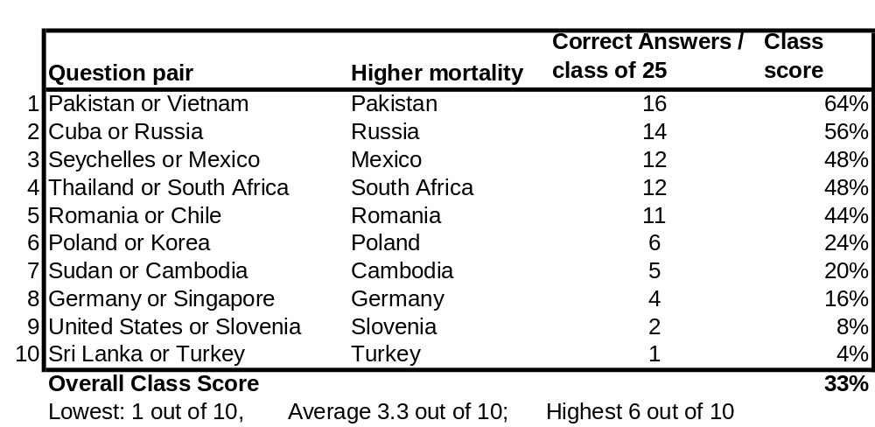
Pre-test of pre-conceptions
Last class score: 3.5 correct out of 10
How did you do on each pair?
19 of 25 (76%) have counter-factual pre-conceptions (<5 correct)

